Slide 1
LinkedIn Ads: The Red-headed
Stepchild of B2B PPC
AJ Wilcox | @WilcoxAJ
Founder | B2Linked.com
Your Company Logo

Slide 2
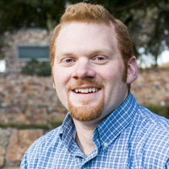
ABOUT AJ WILCOX
Triathlete, exotic car lover, soulless ginger
Years of PPC and SEO experience
9+
Began heavy B2B focus 4 years ago
Live in Utah with
my wife and 4 kids

Slide 3
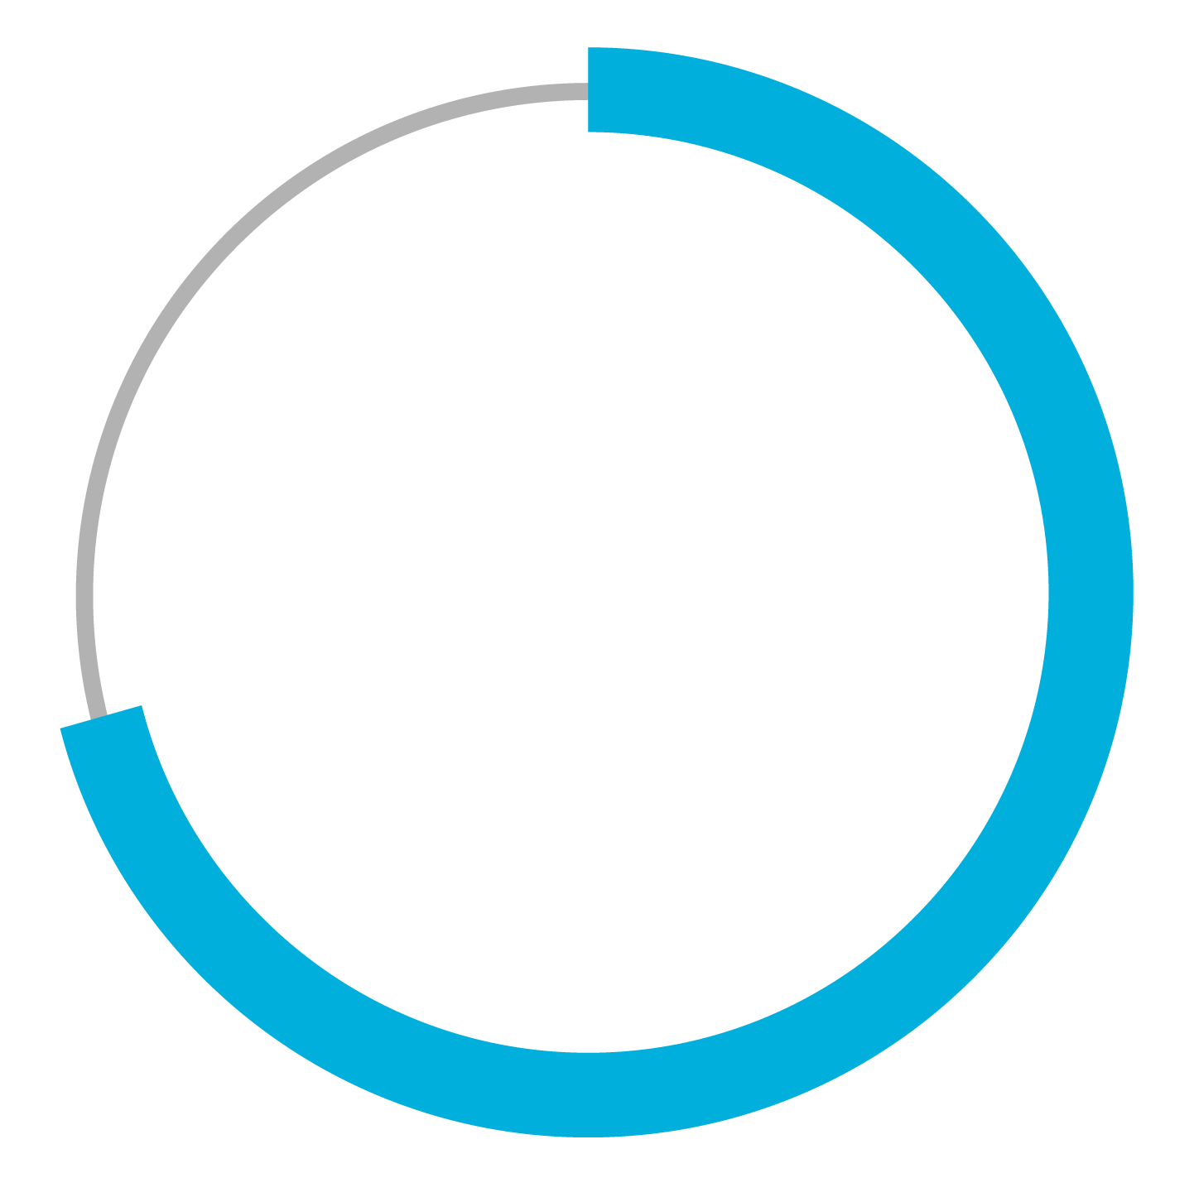
B2B CHALLENGES
B2B Marketers have to be more sophisticated
Inherent Obstacles with B2B:
Delayed Sales Cycles
72%
Fortune 1000
Offline Conversion Events
It’s worth it, though!

Slide 4
KEYWORD TARGETING
Paid Search (AdWords) keyword-based targeting
Budget
Intent-based
CEOs type the same keywords as janitors
How do you ensure your dollars
are spent on someone with B.A.N.T.?
Timing
Authority
Need

Slide 5
B2B AD OPTIONS
B2B TARGETING
PERSONAL FOCUS
BUSINESS FOCUS
LOW COST
HIGH COST
Weak
Decent
Precise
AdTech Vendors
Industry Publications
Advertise in industry rags (ChiefExecutive magazine)

Slide 6
LINKEDIN ADVERTISING - PROS
Up-To-Date
(Self Selected)
Robust Targeting
Business Mentality
No
Gatekeeper
Larger
Deal Sizes
LinkedIn.com/ads

Slide 7
LINKEDIN ADVERTISING - CONS
The platform is far from perfect:
Conversion Tracking
Device-level Bidding
Dayparting
Retargeting
Hourly Reporting
Opaque Relevancy Score
Ignored by LinkedIn (Changing!)

Slide 8
WHO’S A FIT?
Who’s an ideal fit for LinkedIn Advertising?
Company Verticals:
LTV >$20K
Subscription Software (SaaS)
is a no-brainer
Recruiting
Education

Slide 9
NOT A FIT!
Small LTVs (<$10K)
Broad
Target
B2C
eCommerce
Hard Sell

Slide 10
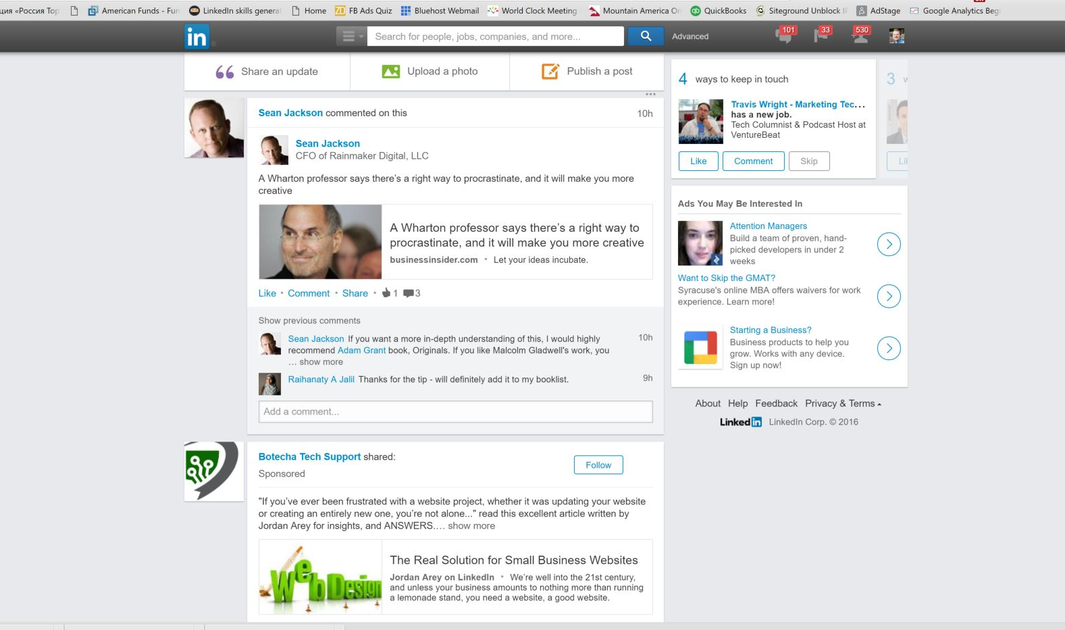
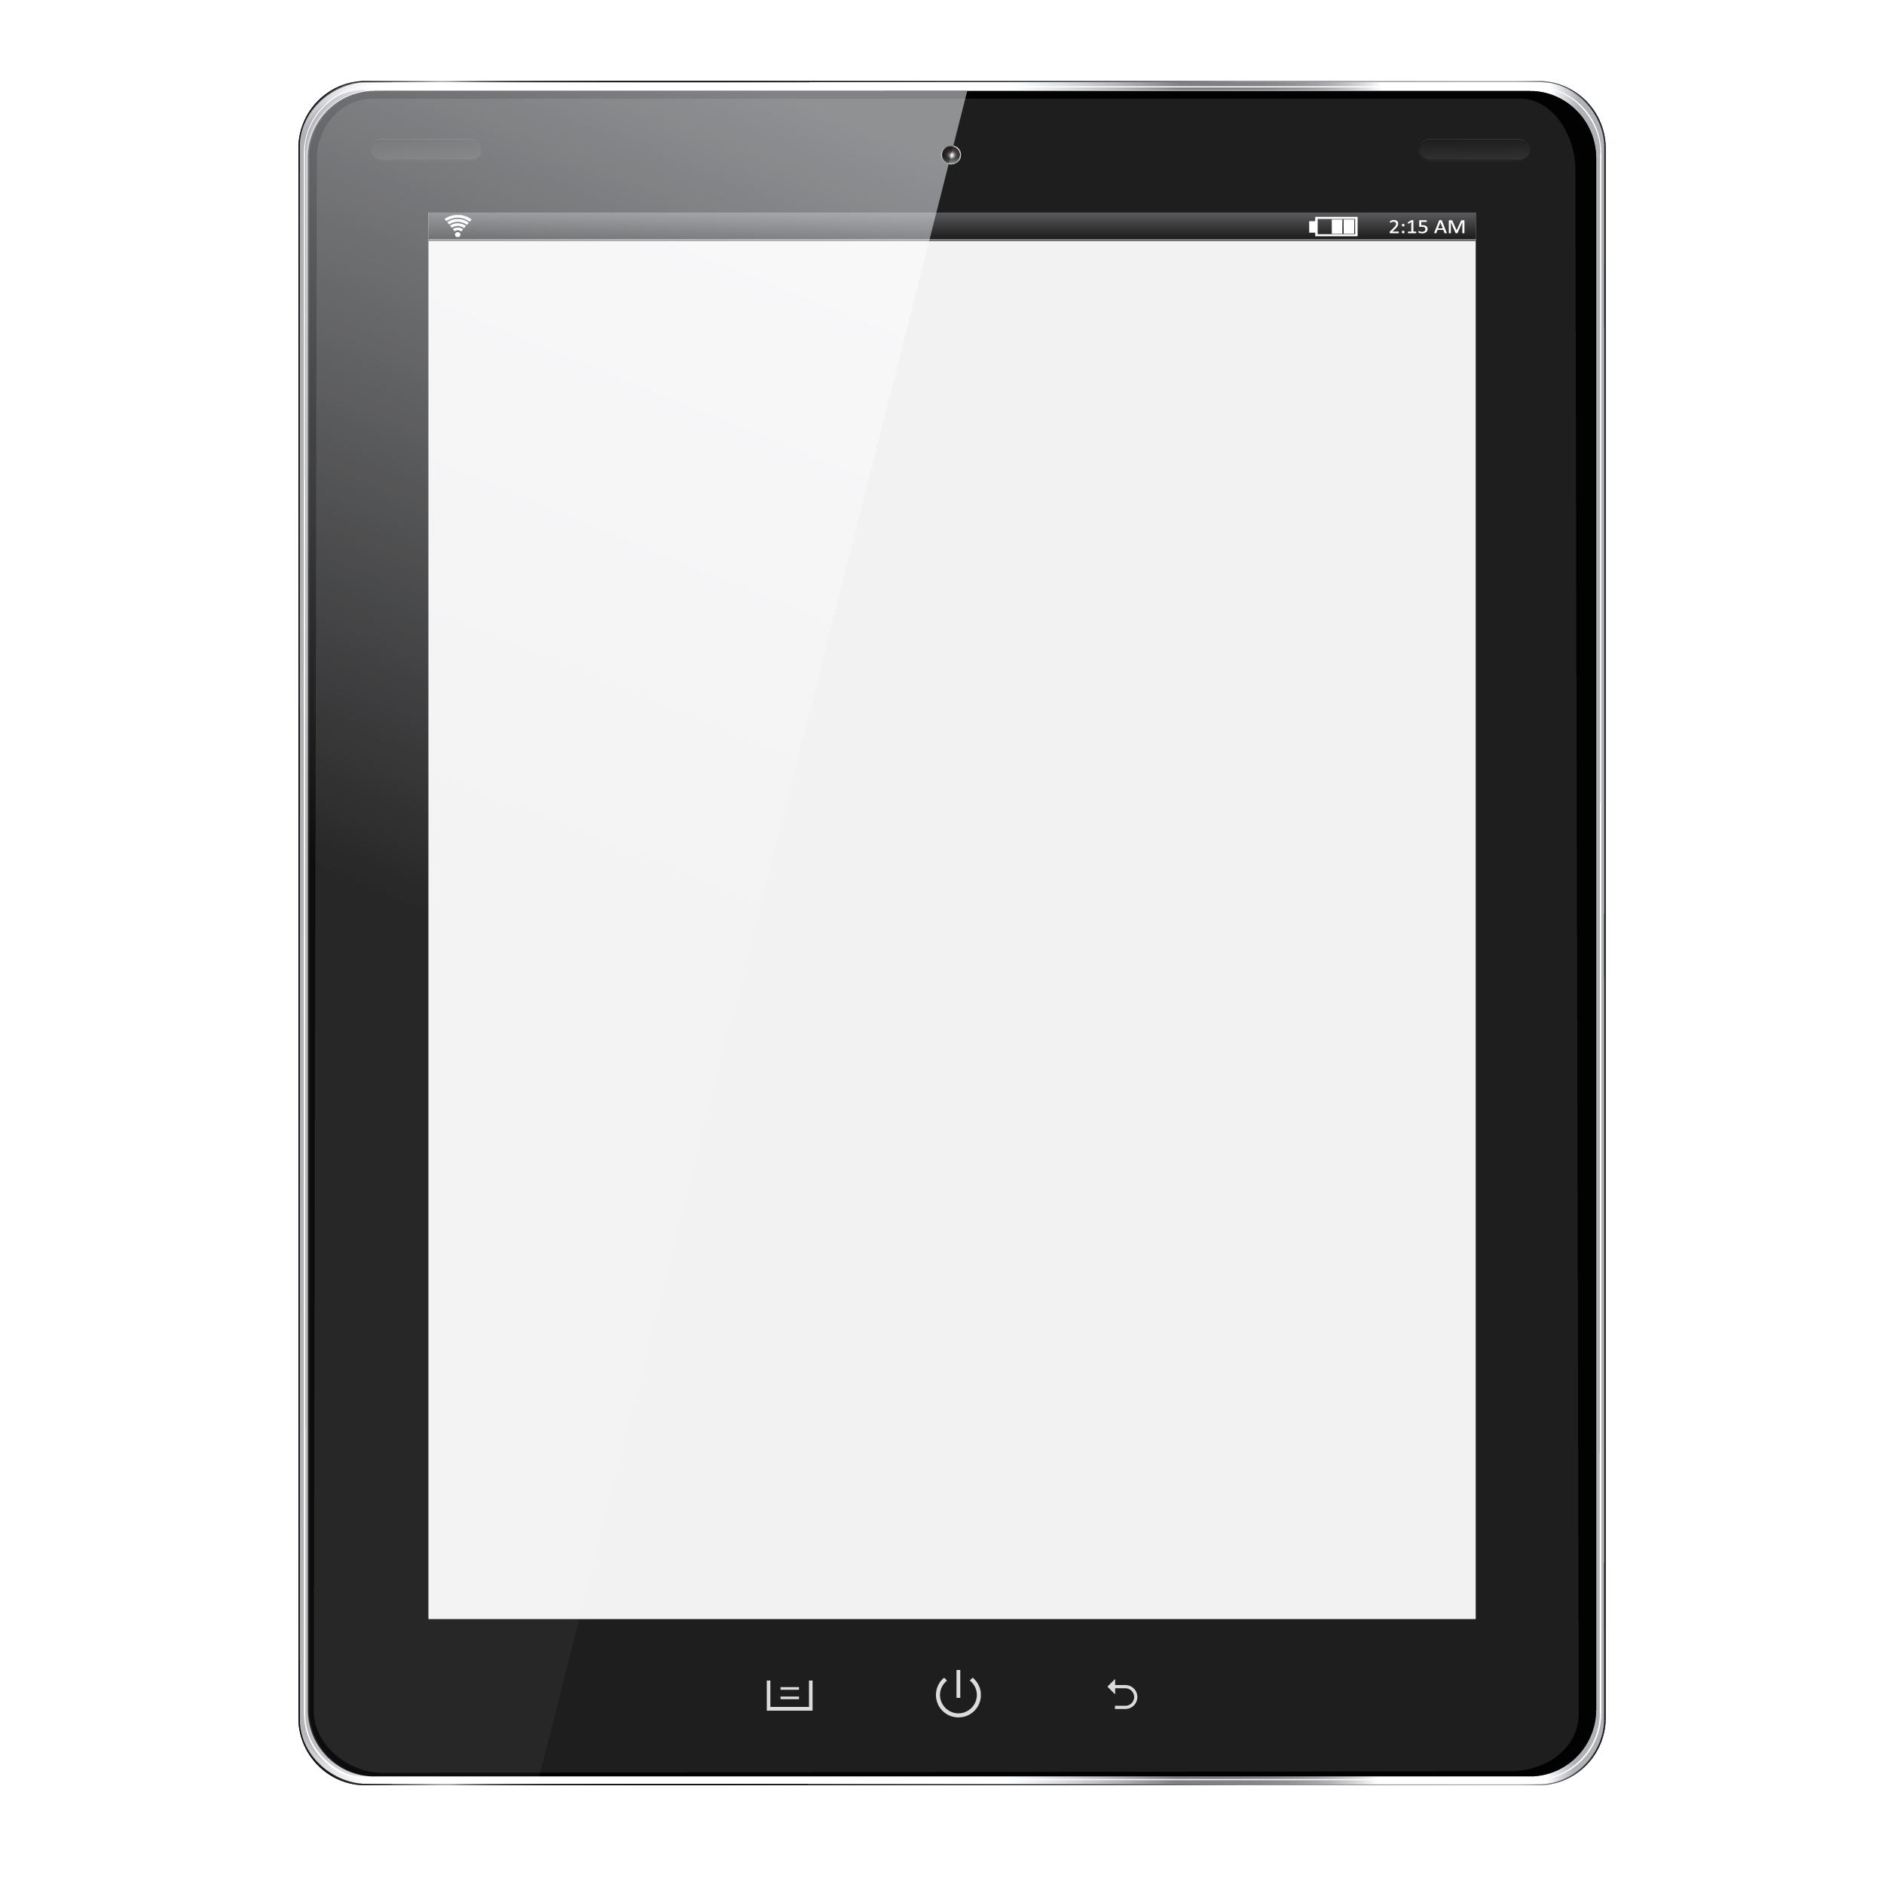
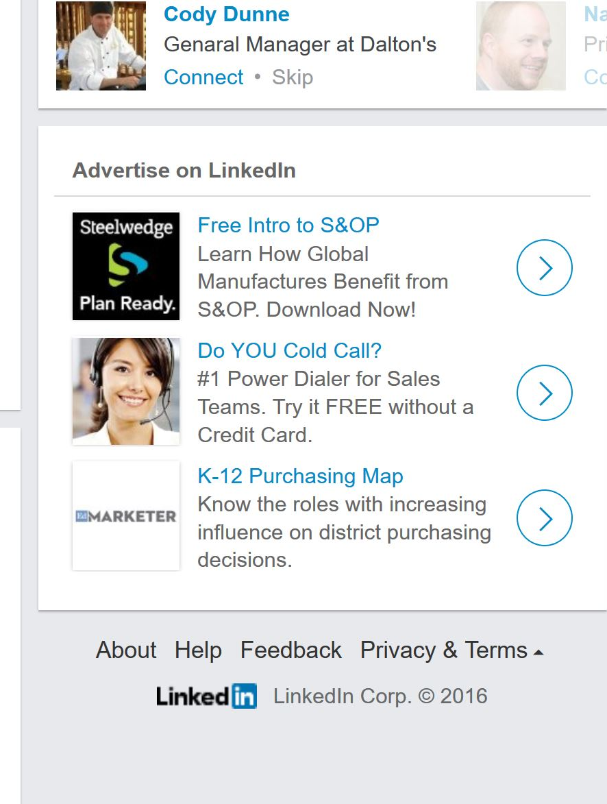
AD UNITS – TEXT ADS
50x50px image
.04% CTR is good
25 char headline
75 char adline
Desktop ONLY

Slide 11
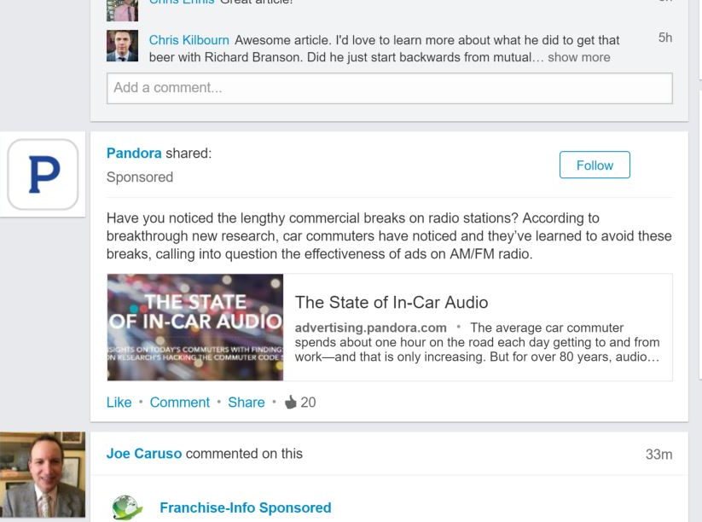
AD UNITS – SPONSORED UPDATES
180x110px image
.4% CTR is good
128 char intro
38 char title
155 char description
Mostly mobile users

Slide 12
B2B TARGETING
Profile Completeness Dependent
Professional
Education
Job Title (Project Manager)
School Name (Stanford)
Job Function (Marketing)
Degree/Field of Study
Seniority (Manager)
Skills (Nunchuck, MySQL)
Demographics
Group (Project Management R Us)
Gender (M/F/Both)
Age (55+)
Company
Geography (San Francisco Bay Area)
Category/Industry (Hi-tech, Consumer Goods)
Combinations & Exclusions
Company Size (51 - 2000)
Company Name (Microsoft)

Slide 13
CONTENT MARKETING FUNNEL
Blog Post/Infographic
Low Friction
Guide / Whitepaper
Retargeting
Ebook
Email Nurture
Webinar
High Friction
Trial/
Demo

Slide 14
GLORIOUS RETARGETING
Paid Search retargeting = Building audience around keyword
LinkedIn retargeting = Building persona!
Recommended Retargeting Mix:
Tag Manager Containing:
AdWords ReMarketing
Facebook Custom Audiences
Twitter Tailored Audiences

Slide 15
Q&A
Rod@CleanDigital.co.uk
@RodPPC
CleanDigital.co.uk
AJ@B2Linked.com
@WilcoxAJ
www.B2Linked.com

Slide 16
EFFICIENT LINKEDIN REACH
Titles
Titles
Groups (+ Seniority)
Skills
CMO
Groups
Job Function + Seniority
Skills + Seniority
Job Function

Slide 17
Titles
Skills
CMO
Groups
Job Function

Slide 18
WHO USES LINKEDIN ADS?
Q4 2014 Ad Revenues (Millions)
$20,000
$18,100
$18,000
$16,000
$14,000
$12,000
$10,000
$8,000
$6,000
$3,851
$4,000
$153
$243
$2,000
$0
LinkedIn
Twitter
Facebook
Google

